Slide 1

Note: The data and information in this document is reflective of a hypothetical situation and client. This document is to be used for KPMG Virtual Internship purposes only.
Sprocket Central Pty Ltd
Data analytics approach
[Division Name] - [Engagement Manager], [Senior Consultant], [Junior Consultant]

Slide 2
Note: The data and information in this document is reflective of a hypothetical situation and client. This document is to be used for KPMG Virtual Internship purposes only.
Agenda
Introduction
Data Exploration
Model Development
Interpretation

Slide 3
Note: The data and information in this document is reflective of a hypothetical situation and client. This document is to be used for KPMG Virtual Internship purposes only.
Introduction
Customers Analysis
Age distributions
Number of bike purchases in 3 years / percentages purchases
Job industry category.
Wealth segments
Bike Purchased by customers
Customers are located

Slide 4
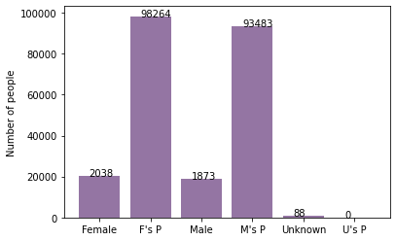

Note: The data and information in this document is reflective of a hypothetical situation and client. This document is to be used for KPMG Virtual Internship purposes only.
Data Exploration
Customers’ age distribution
old
As we can see, mostly our new customers are between 25 to 48 years old.
Number of customers from 48 to 59 years old has big drops on percentages.
There is a slightly increase in number of customers over 59 years old in term of percentages
It looks like the percentages of under 25 years old not really change.
New

Slide 5
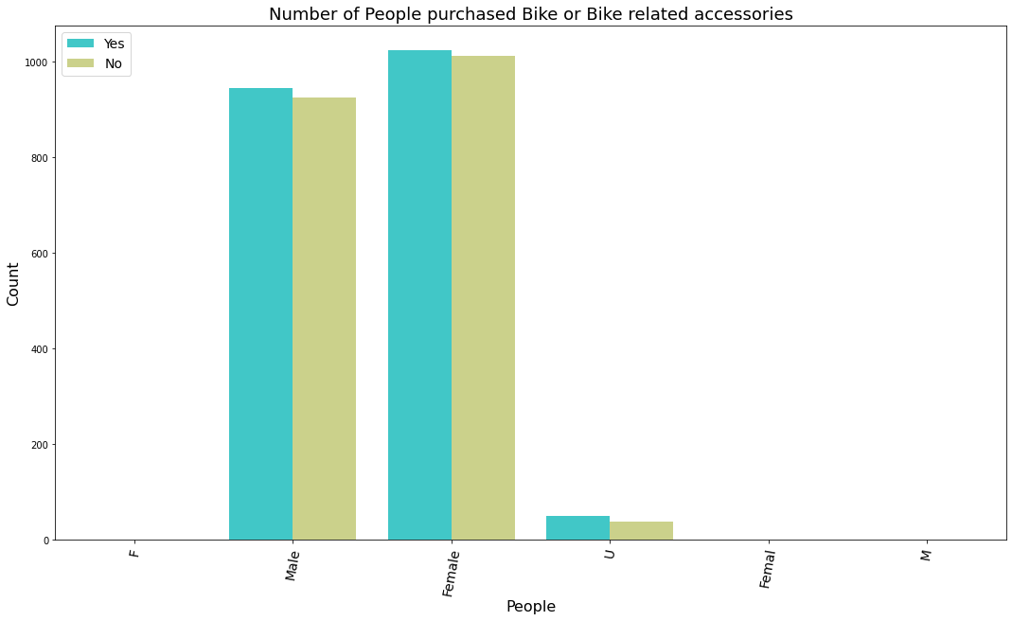
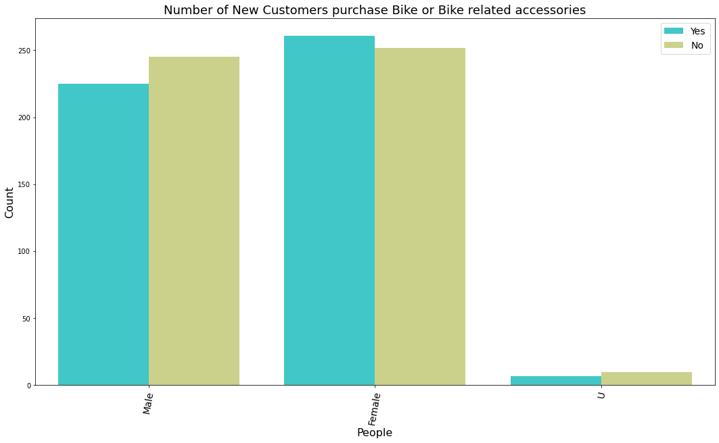
Note: The data and information in this document is reflective of a hypothetical situation and client. This document is to be used for KPMG Virtual Internship purposes only.
Model Development
Bike or Bike related accessories purchases last 3 years
As we can see, our old customers and New customers mostly Female Purcheses Bike or Bike related accessories.
But We can see new customers as compare male also purcheses Bike or bike related accessories.
So we should focus on advertises on Female customers than Male customers
New Customers

Slide 6
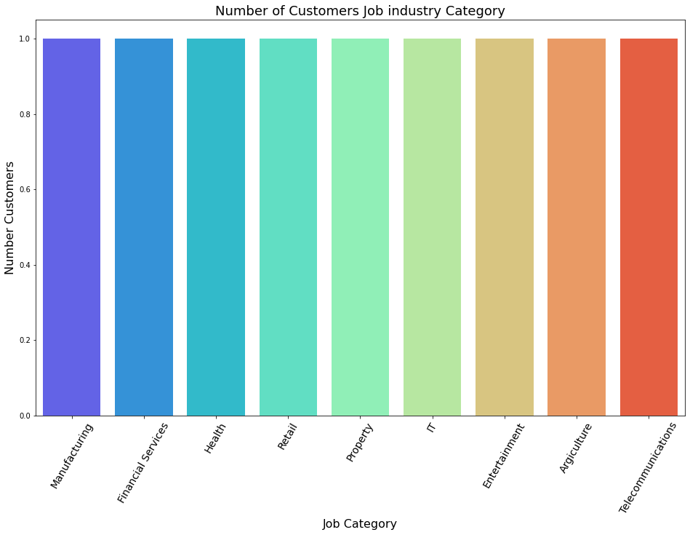

Note: The data and information in this document is reflective of a hypothetical situation and client. This document is to be used for KPMG Virtual Internship purposes only.
Interpretation
Job industry category
Mostly our new customers are on Finance industry and our Manufacturing customers are still on top 2.
The rest industries is still same
New Customers
data

Slide 7
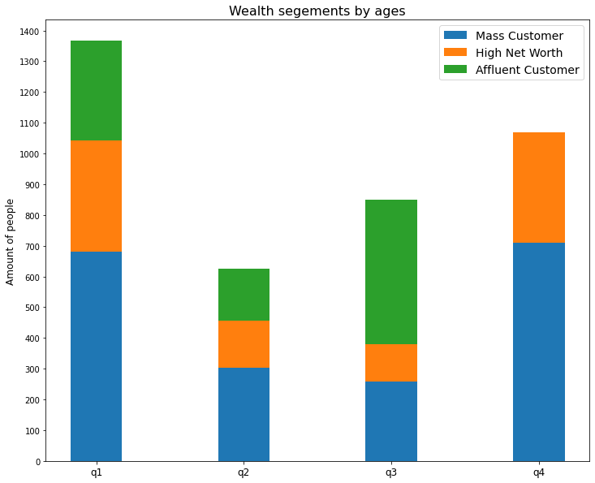
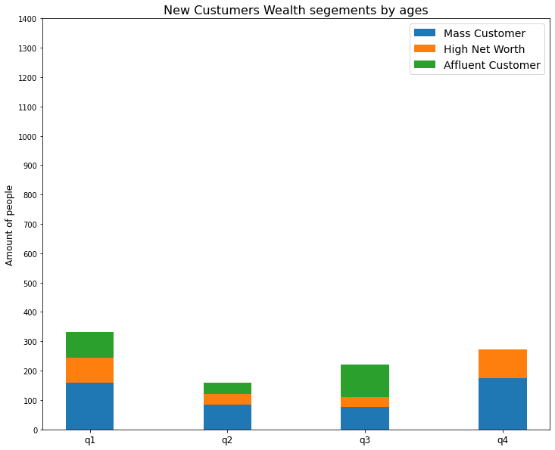
Note: The data and information in this document is reflective of a hypothetical situation and client. This document is to be used for KPMG Virtual Internship purposes only.
Interpretation
Wealth segments
New Customers
data
In all ages, the number of Mass Customers is the highest so we should focus on this social class.
After that, we should focus on High Net Customer.
Then Affluent Customers but mostly second and third quadrant

Slide 8
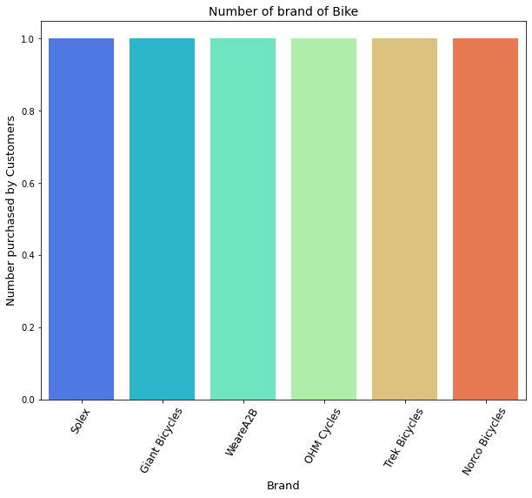
Note: The data and information in this document is reflective of a hypothetical situation and client. This document is to be used for KPMG Virtual Internship purposes only.
Interpretation
Bike Purchased by customers
We can see Number of Customers Purchased every Brand of Bikes and Bike related accessories.
So we can Promote or marketing all brand equally.

Slide 9
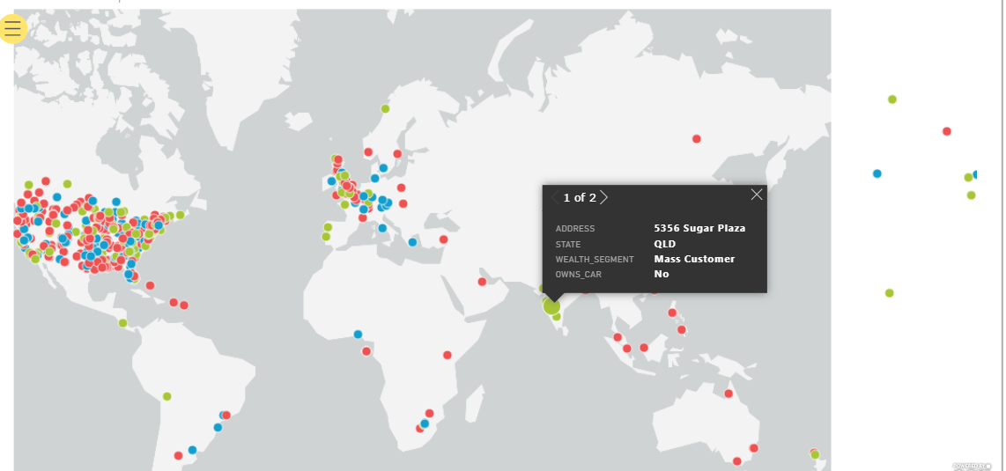
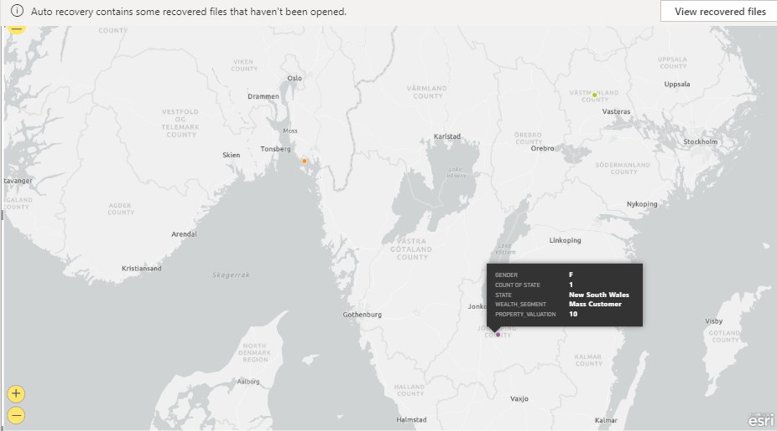
Note: The data and information in this document is reflective of a hypothetical situation and client. This document is to be used for KPMG Virtual Internship purposes only.
Interpretation
Customers are located
In this PPT not visualize well. We can visualize geographical map where customers are located at PowerBI tool or any Visualization tool.

Slide 10
Note: The data and information in this document is reflective of a hypothetical situation and client. This document is to be used for KPMG Virtual Internship purposes only.
Appendix

Slide 11
Note: The data and information in this document is reflective of a hypothetical situation and client. This document is to be used for KPMG Virtual Internship purposes only.
Appendix
All supporting items in that attachment.

